Slide 1
HYPOTHESIS TESTING AND STATISTICAL TESTS

Slide 2
What is Statistics?

Slide 3
What is Statistics?
Statistics is the science of:
  Collecting data
  Organizing data
  Analyzing data
  Interpreting data
  Drawing conclusions from data

Slide 4
Descriptive Statistics

Slide 5
Descriptive Statistics
Describes the data we already have.
Examples:
  Mean
  Median
  Mode
  Variance
  Standard deviation
  Graphs

Slide 6
Inferential Statistics

Slide 7
Inferential Statistics
Uses a sample to make conclusions about a population.
Examples:
  Hypothesis testing
  Confidence intervals
  Regression
  ANOVA
  Z-test
  T-test

Slide 8
Inferential Statistics
Uses a sample to make conclusions about a population.
Examples:
  Hypothesis testing
  Confidence intervals
  Regression
  ANOVA
  Z-test
  T-test

Slide 9
What is Statistical Inference?
Suppose we want to know the average marks of all students in a university.

Slide 10
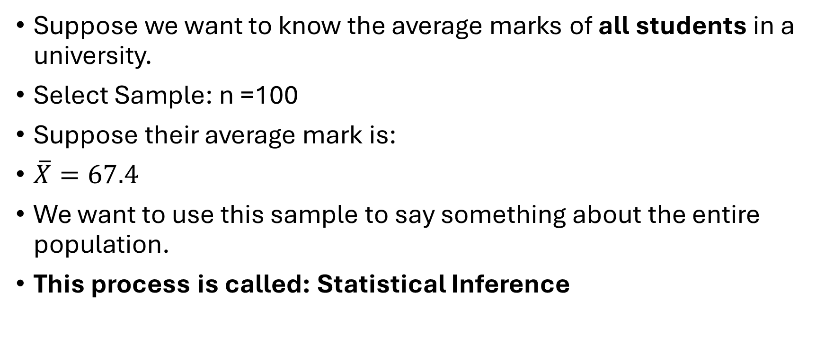
What is Statistical Inference?
Suppose we want to know the average marks of all students in a university.
Select Sample: n =100
Suppose their average mark is:
$\overline{X}=67.4$
We want to use this sample to say something about the entire population.
This process is called: Statistical Inference​

Slide 11
Major components of – Statistical Inference
Estimation
Hypothesis testing

Slide 12

Population
$μ=\text{population mean}$
$σ=\text{population standard deviation}$
$σ^{2}=\text{population variance}$
p=population proportion

Slide 13

Sample
Important sample quantities are:
$\overline{X}=\text{sample mean}$
$s=\text{sample standard deviation}$
$s^{2}=\text{sample variance}$
$\hat{p}=\text{sample proportion}$

Slide 14
What is a Parameter?

Slide 15
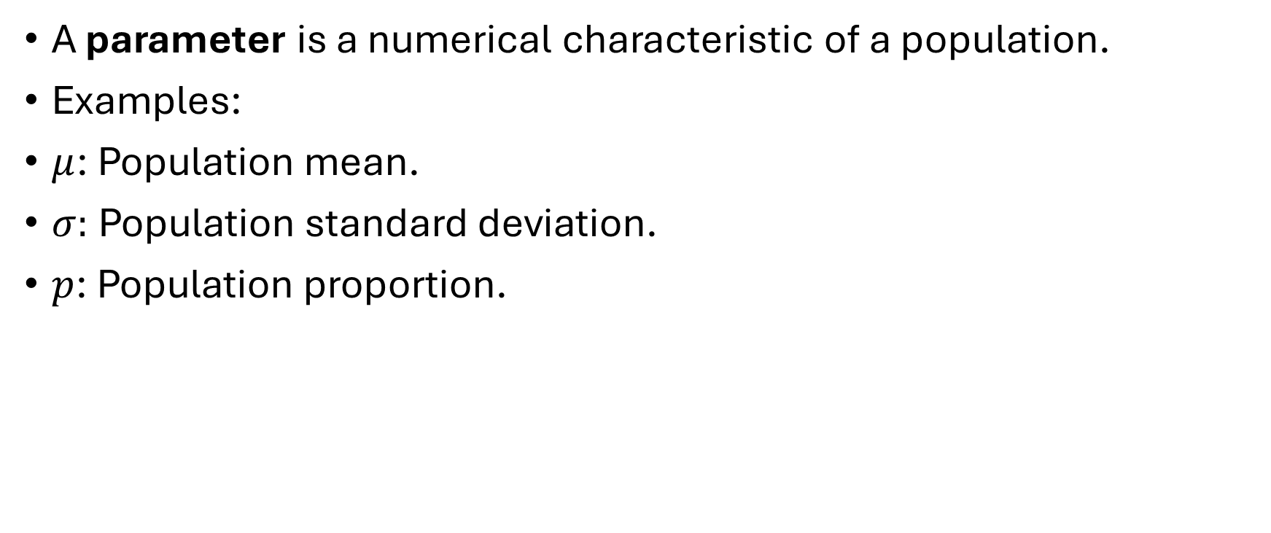
What is a Parameter?
A parameter is a numerical characteristic of a population.
Examples:
$μ$: Population mean.
$σ:$Population standard deviation.
$p$: Population proportion.

Slide 16
Sampling Distribution

Slide 17
Sampling Distribution
Suppose we repeatedly take samples of size 100.

Slide 18
Sampling Distribution
Suppose we repeatedly take samples of size 100.
Sample | Sample Mean

Slide 19

Sampling Distribution
Suppose we repeatedly take samples of size 100.
The distribution of all possible sample means is called the:
$\boxed{\text{Sampling distribution of }\overline{X}}$
Sample | Sample mean
1 | 68.4
2 | 71.2
3 | 69.8
4 | 72.1
5 | 70.3

Slide 20

Standard Error
For the sample mean:
$SE_{\overline{X}}=\frac{σ}{\sqrt{n}}$
If $σ$is unknown:
$SE_{\overline{X}}≈\frac{s}{\sqrt{n}}$

Slide 21

Numerical Example — Standard Error
Suppose:
$σ=20$
and:
n=100
Calculate:?????

Slide 22

Numerical Example — Standard Error
Suppose:
$σ=20$
and:
n=100
Calculate:?????
Now increase sample size:

Slide 23

Numerical Example — Standard Error
Suppose:
$σ=20$
and:
n=100
Calculate:?????
Now increase sample size:
Therefore:
$n↑⇒SE↓$

Slide 24
HYPOTHESIS TESTING
Hypothesis testing is a statistical procedure used to determine whether sample data provide sufficient evidence against a stated null hypothesis about a population.

Slide 25
HYPOTHESIS TESTING

Slide 26

Real-Life Example
Suppose a company claims:
Average battery life is 10 hours.
We collect a sample.
Suppose:
$n=36$
and:
Xˉ=10.8

Slide 27
Real-Life Example
The question is:
Is 10.8 sufficiently different from 10 to conclude that the company's claim is questionable?
This is hypothesis testing.

Slide 28
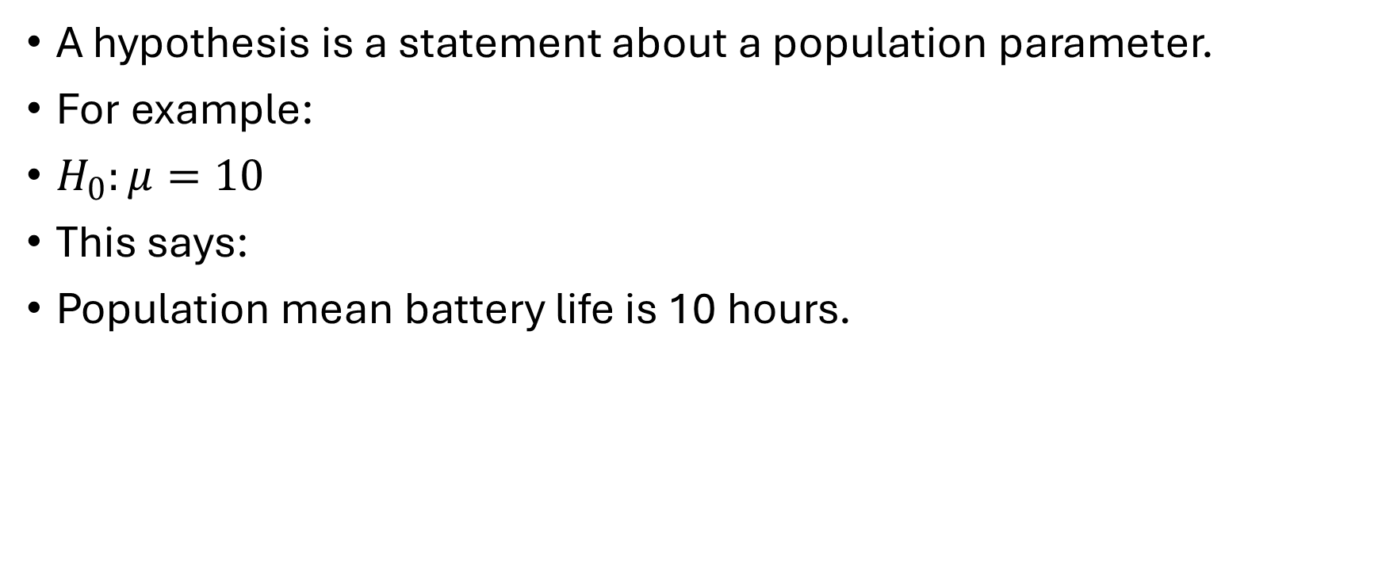
Hypothesis
A hypothesis is a statement about a population parameter.
For example:
$H_{0}:μ=10$
This says:
Population mean battery life is 10 hours.

Slide 29
Hypothesis
A hypothesis is a statement about a population parameter.
For example:
$H_{0}:μ=10$
This says:
Population mean battery life is 10 hours.

Slide 30
Null Hypothesis

Slide 31

Null Hypothesis
The null hypothesis is represented by:
  $\boxed{H_{0}}$
It generally represents:
  No difference
  No effect
  No relationship
  Existing/default condition

Slide 32

Null Hypothesis
Examples:
$H_{0}:μ=50$
$H_{0}:μ_{1}=μ_{2}$

Slide 33

Alternative Hypothesis
Represented by:
$\boxed{H_{1}}$
or:
$\boxed{H_{a}}$

Slide 34

Alternative Hypothesis
Examples:
Two-sided
  $H_{1}:μ≠50$
Right-sided
  $H_{1}:μ>50$
Left-sided
  $H_{1}:μ<50$

Slide 35
One-Tailed and Two-Tailed Tests

Slide 36

Two-Tailed Tests
Suppose:
$H_{0}:μ=50$
$H_{1}:μ≠50$
We are interested in both:
  $μ>50$
and:
  μ<50

Slide 37

Right-tailed
Right-tailed
$H_{0}:μ=50$
$H_{1}:μ>50$

Slide 38

Left-tailed
Left-tailed
$H_{0}:μ=50$
$H_{1}:μ<50$

Slide 39

Significance Level
Most commonly:
$\boxed{α=0.05}$

Slide 40
Type I Error

Slide 41

Type I Error
Rejecting $H_{0}$when it is actually true.
$P\left(\text{Type I Error}\right)=α$

Slide 42
Type I Error
Example:
Actually: New medicine has no effect.
But we conclude:New medicine has an effect.
That is Type I error.

Slide 43

Type II Error
Failing to reject $H_{0}$when it is actually false.
P(Type II Error)=β

Slide 44
Type II Error
Failing to reject $H_{0}$when it is actually false.
P(Type II Error)=β

Slide 45

Statistical Power
$\boxed{Power=1−β}$
Power is the probability of detecting an effect when that effect truly exists, under a specified alternative.

Slide 46
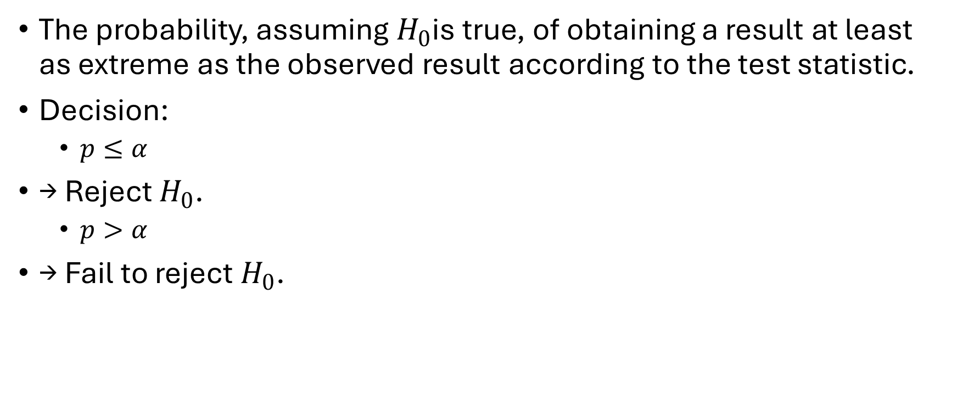
p-value
The probability, assuming $H_{0}$is true, of obtaining a result at least as extreme as the observed result according to the test statistic.
Decision:
  $p≤α$
→ Reject $H_{0}$.
  $p>α$
→ Fail to reject $H_{0}$.

Slide 47
General Hypothesis Testing Procedure

Slide 48

General Hypothesis Testing Procedure
Step 1
State:
$H_{0}$

Slide 49

General Hypothesis Testing Procedure
Step 2
State:
$H_{1}$

Slide 50

General Hypothesis Testing Procedure
Step 3
Choose:
$α$

Slide 51
General Hypothesis Testing Procedure
Step 4
Choose appropriate statistical test.
Step 5
Calculate test statistic.
Step 6
Determine p-value or critical value.
Step 7
Make decision.
Step 8
Write conclusion in words.

Slide 52
Z-TEST
A Z-test is a hypothesis test using the standard normal distribution.

Slide 53
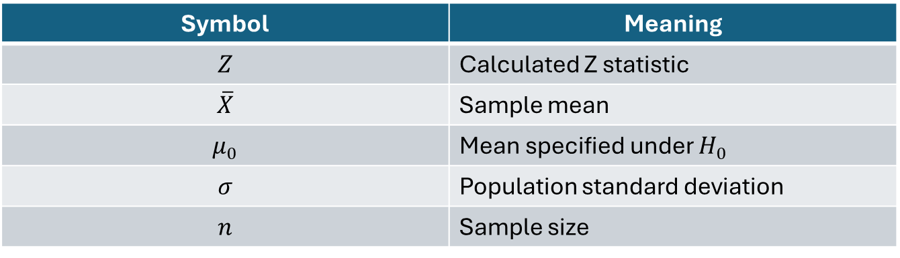

Z-TEST
For testing a population mean when population SD is known:
$\boxed{Z=\frac{\overline{X}−μ_{0}}{σ/\sqrt{n}}}$
Symbol | Meaning
$$Z$$ | Calculated Z statistic
$$\overline{X}$$ | Sample mean
$$μ_{0}$$ | Mean specified under $H_{0}$
$$σ$$ | Population standard deviation
$$n$$ | Sample size

Slide 54
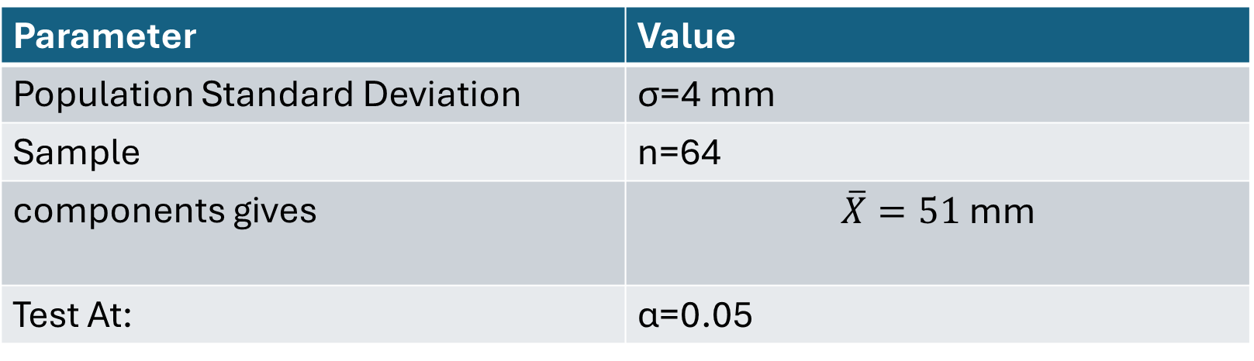
Example
A company claims that its machine produces components with an average diameter of: μ0​=50 mm
Parameter | Value
Population Standard Deviation | σ=4 mm
Sample | n=64
components gives | $$\overline{X}=51\text{ mm}$$
Test At: | α=0.05

Slide 55

Step 1 — Hypotheses
Because we want to know whether the mean is different:
$H_{0}:μ=50$
$H_{1}:μ≠50$
Two-tailed test.

Slide 56

Step 2 — Formula
Step 2 — Formula
              $Z=\frac{\overline{X}−μ_{0}}{σ/\sqrt{n}}$

Slide 57

Step 2 — Formula
Step 2 — Formula
              $Z=\frac{\overline{X}−μ_{0}}{σ/\sqrt{n}}$
Z= 2

Slide 58
Step 4 — Critical Value
At:
α=0.05
for a two-tailed test: Zcritical ​=±1.96

Slide 59

Step 4 — Critical Value
At:
α=0.05
for a two-tailed test: Zcritical ​=±1.96
$0.05→0.025$ in each tail → cumulative area $0.975$→ Z-table gives 1.96.

Slide 60

Step 5 — Decision
Calculated:
$Z=2$
Since:
$2>1.96$
we reject:
H0​

Slide 61
Step 6 — Conclusion
There is statistically significant evidence at the 5% significance level that the population mean diameter differs from 50 mm.

Slide 62
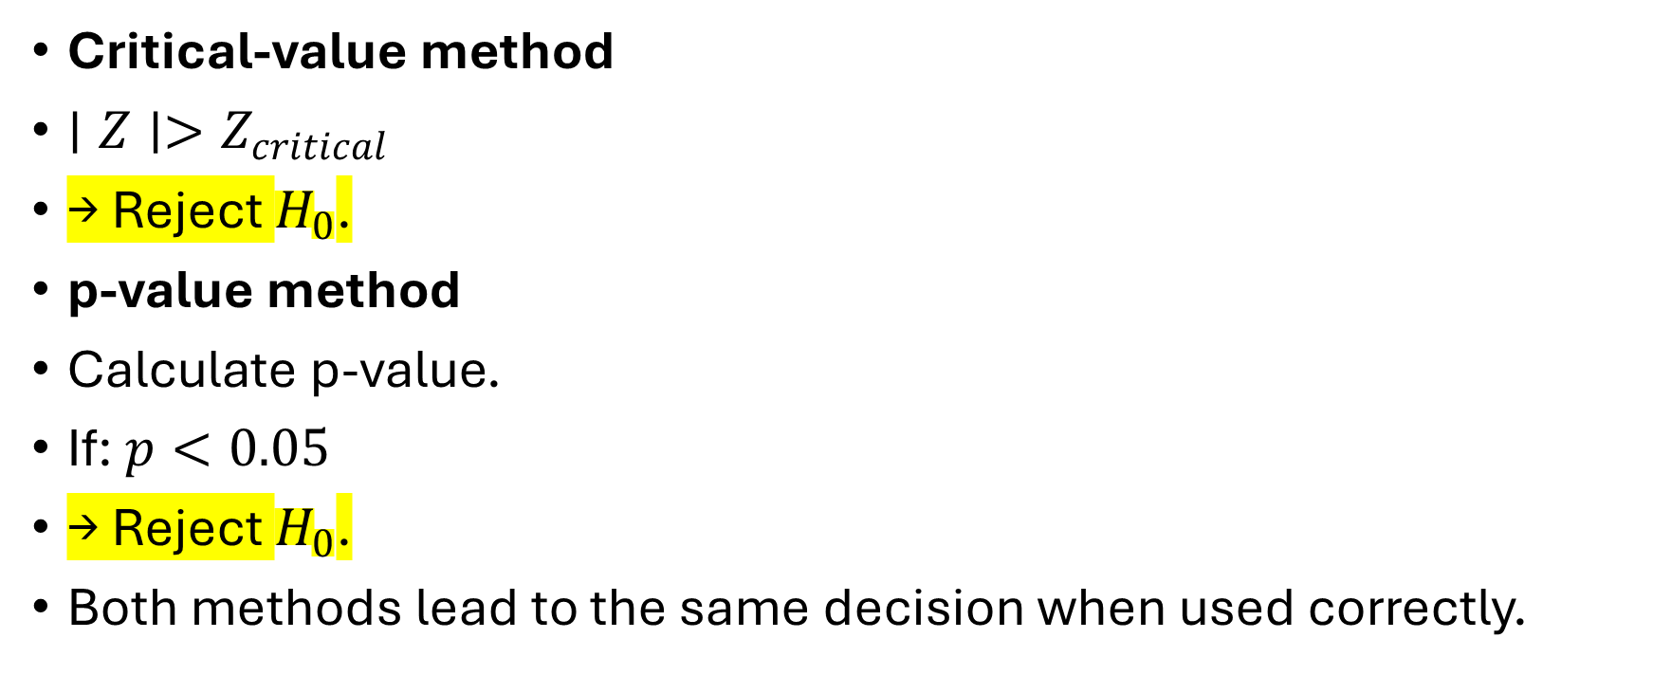
Critical Value Method vs p-value Method
Critical-value method
$∣Z∣>Z_{critical}$
→ Reject $H_{0}$.
p-value method
Calculate p-value.
If: $p<0.05$
→ Reject $H_{0}$.
Both methods lead to the same decision when used correctly.

Slide 63
When Z-Test Is Appropriate
Typical conditions include:
  Population SD known for the classical one-sample mean Z-test.
  Random/representative sampling.
  Independence.
  Normal population or a sufficiently large sample under appropriate conditions.

Slide 64

Where Z-Test Can Fail
Case 1
$σ$ is unknown and $n$ is small. Use a t-test under appropriate assumptions.

Slide 65
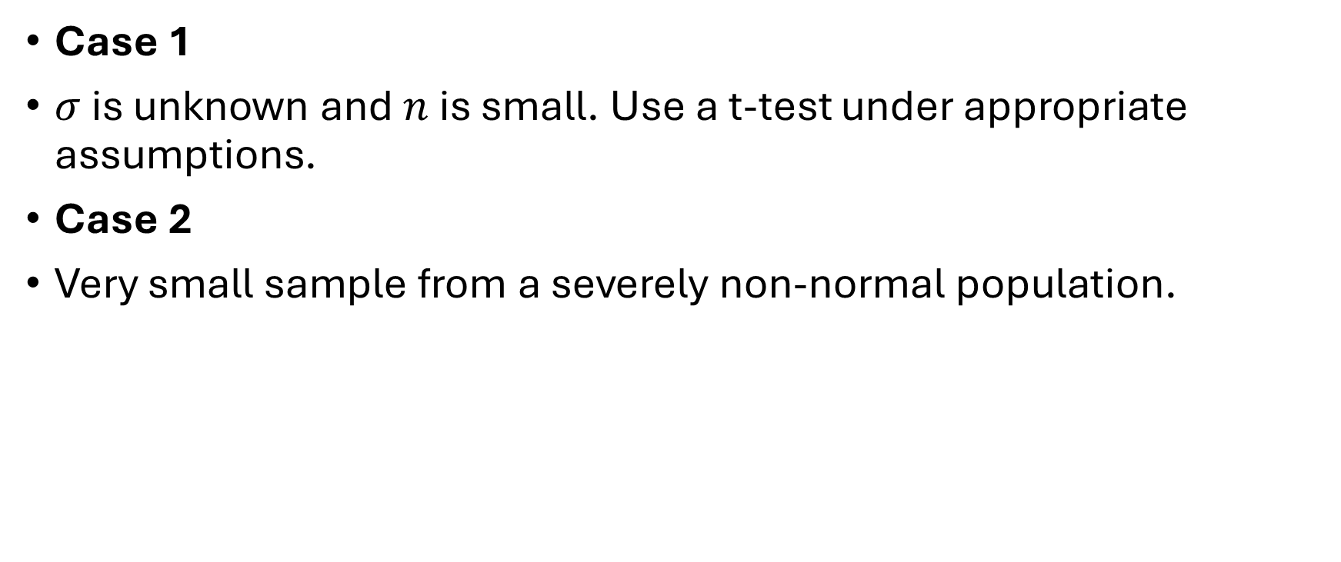
Where Z-Test Can Fail
Case 1
$σ$ is unknown and $n$ is small. Use a t-test under appropriate assumptions.
Case 2
Very small sample from a severely non-normal population.

Slide 66
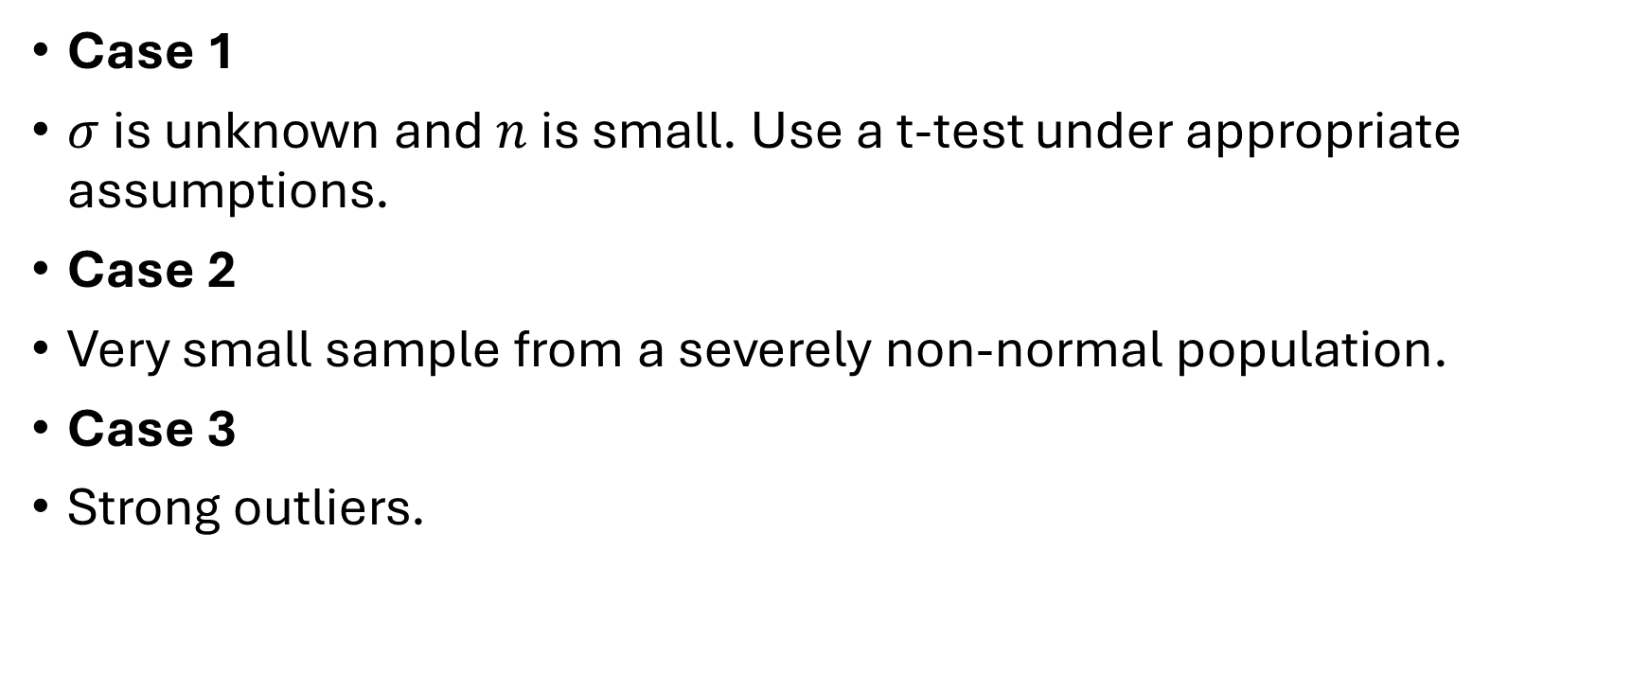
Where Z-Test Can Fail
Case 1
$σ$ is unknown and $n$ is small. Use a t-test under appropriate assumptions.
Case 2
Very small sample from a severely non-normal population.
Case 3
Strong outliers.

Slide 67
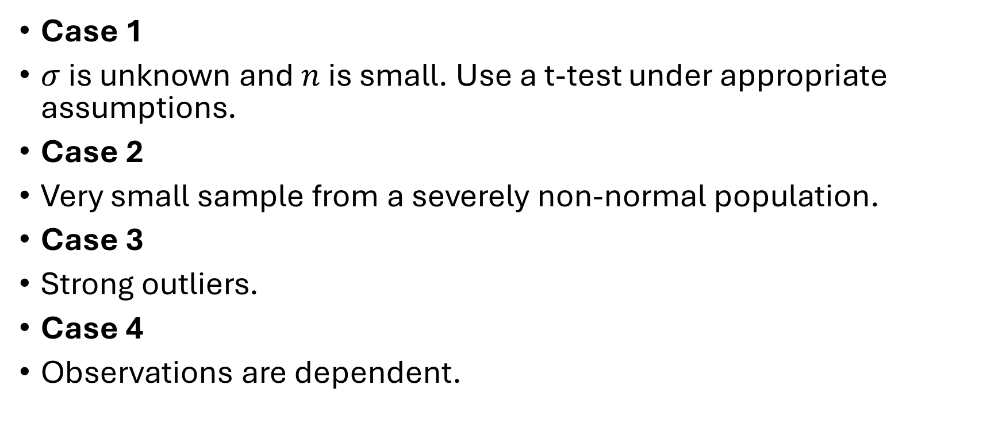
Where Z-Test Can Fail
Case 1
$σ$ is unknown and $n$ is small. Use a t-test under appropriate assumptions.
Case 2
Very small sample from a severely non-normal population.
Case 3
Strong outliers.
Case 4
Observations are dependent.

Slide 68

T-TEST
Suppose the population standard deviation: $σ$ is unknown.

Slide 69
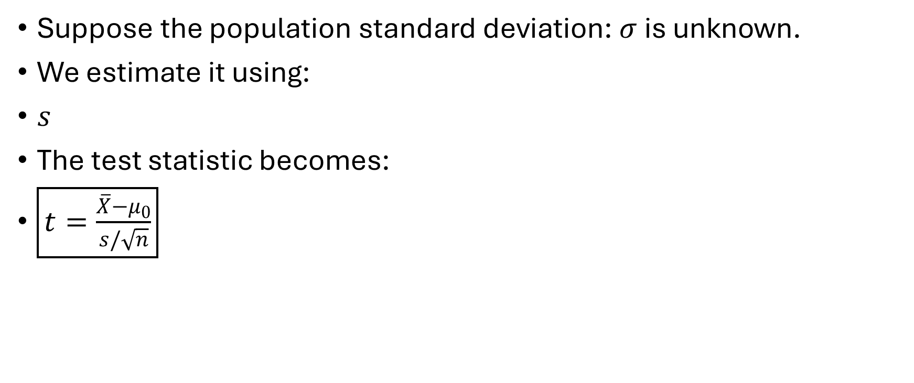
T-TEST
Suppose the population standard deviation: $σ$ is unknown.
We estimate it using:
$s$
The test statistic becomes:
$\boxed{t=\frac{\overline{X}−μ_{0}}{s/\sqrt{n}}}$

Slide 70
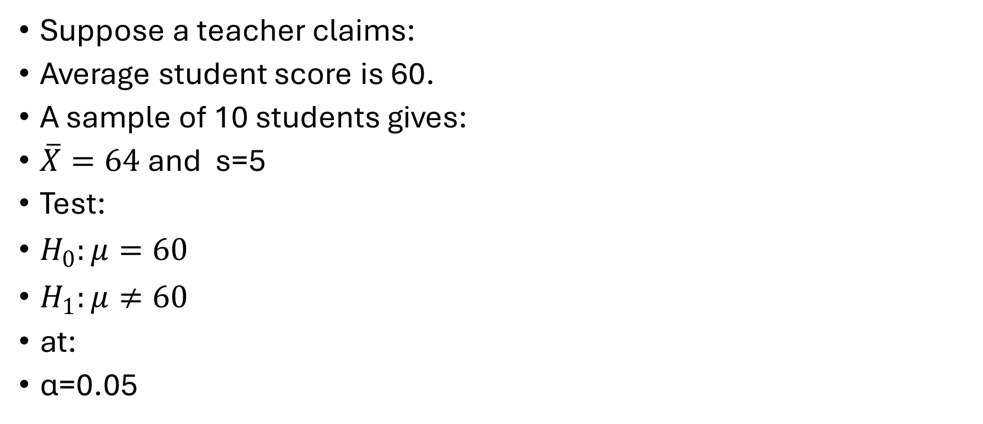
One-Sample T-Test Numerical
Suppose a teacher claims:
Average student score is 60.
A sample of 10 students gives:
$\overline{X}=64$ and s=5
Test:
$H_{0}:μ=60$
$H_{1}:μ≠60$
at:
α=0.05

Slide 71

Step 1
Calculate:
$t=\frac{\overline{X}−μ_{0}}{s/\sqrt{n}}$

Slide 72

Step 1
Calculate:
$t=\frac{\overline{X}−μ_{0}}{s/\sqrt{n}}$
t≈2.53​

Slide 73
Degrees of Freedom

Slide 74

Degrees of Freedom
df=n−1
$df=10−1$
df=9​

Slide 75

Critical Value
For:
$α=0.05$
two-tailed test and:
$df=9$
approximately:
$t_{critical}=2.262$

Slide 76

Step 5 — Decision
$∣2.53∣>2.262$
Therefore: $RejectH_{0}$

Slide 77

Step 5 — Decision
$∣2.53∣>2.262$
Therefore: $Reject{ H}_{0}$
There is sufficient statistical evidence at the 5% significance level that the population mean score differs from 60.

Slide 78
ONE-WAY ANOVA

Slide 79
What is ANOVA

Slide 80
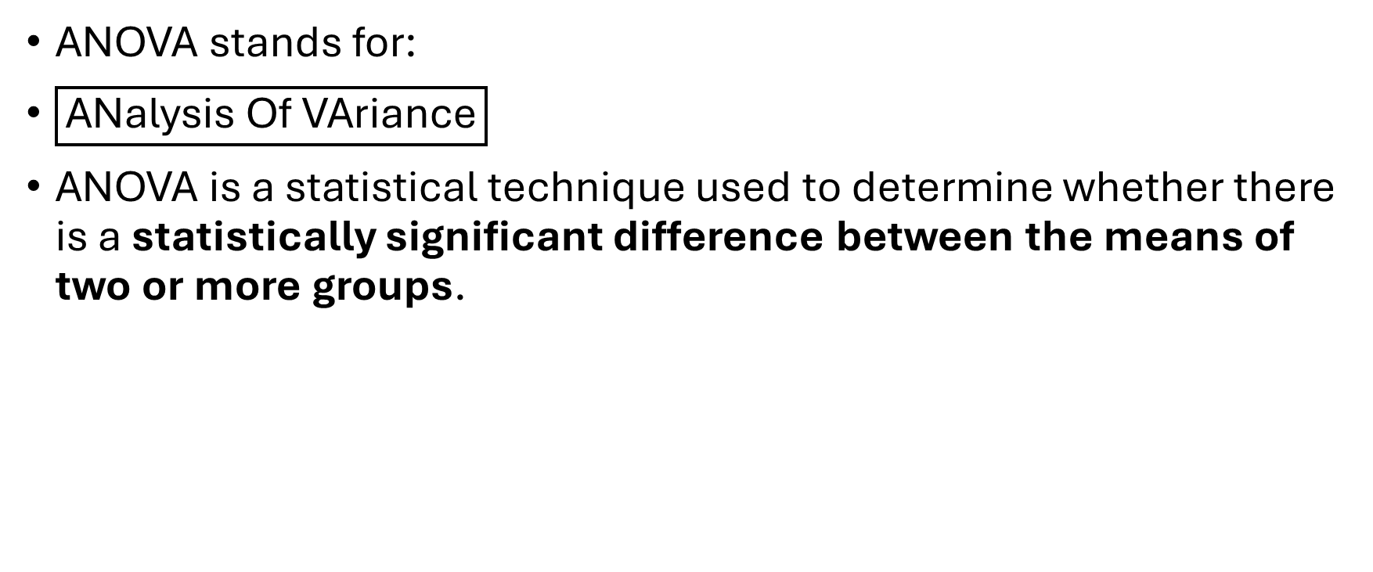
What is ANOVA
ANOVA stands for:
$\boxed{\text{ANalysis Of VAriance}}$
ANOVA is a statistical technique used to determine whether there is a statistically significant difference between the means of two or more groups.

Slide 81
Why is it called Analysis of Variance?
ANOVA is used to compare means, so why is it called Analysis of Variance?

Slide 82
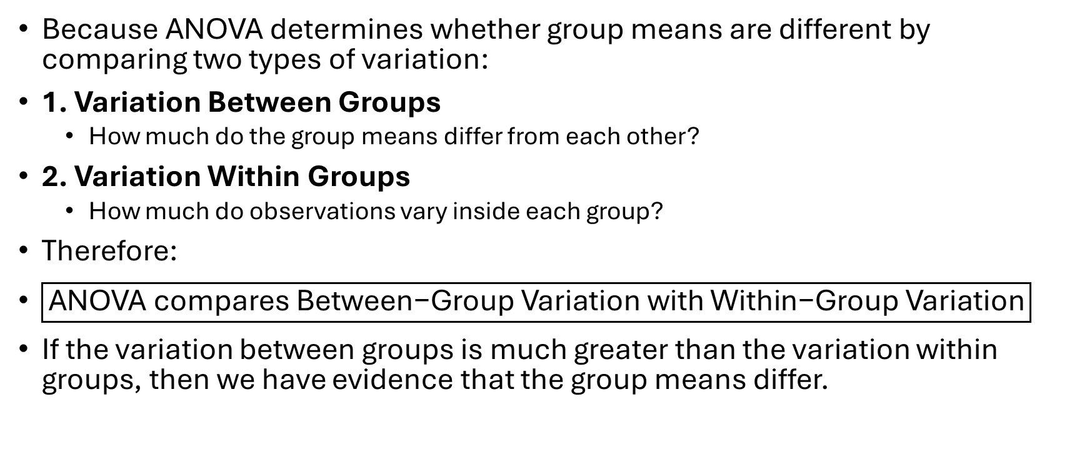
Why is it called Analysis of Variance?
Because ANOVA determines whether group means are different by comparing two types of variation:
1. Variation Between Groups
  How much do the group means differ from each other?
2. Variation Within Groups
  How much do observations vary inside each group?
Therefore:
$\boxed{\text{ANOVA compares Between−Group Variation with Within−Group Variation}}$
If the variation between groups is much greater than the variation within groups, then we have evidence that the group means differ.

Slide 83

Basic ANOVA Idea
$\boxed{F=\frac{\text{Variation Between Groups}}{\text{Variation Within Groups}}}$
This is the central idea behind ANOVA.

Slide 84
Example
Suppose we have marks from three classes.
Calculate : Xa, Xb, Xc
CLASS | MARKS
A | 60, 62, 58, 61, 59
B | 61, 63, 60, 62, 64
C | 80, 82, 78, 81, 79

Slide 85

Example
Clearly, Class C appears different.
ANOVA formally tests:
$H_{0}:μ_{A}=μ_{B}=μ_{C}$
against:
H1​:At least one mean is different
CLASS | MARKS
A | 60, 62, 58, 61, 59
B | 61, 63, 60, 62, 64
C | 80, 82, 78, 81, 79

Slide 86
Types of ANOVA
Type | Number of Factors
One-Way ANOVA | One factor
Two-Way ANOVA | Two factors
Repeated Measures ANOVA | Same subjects measured repeatedly
Three-Way ANOVA | Three factors
MANOVA | Multiple dependent variables

Slide 87

ONE-WAY ANOVA CONCEPT
One-Way ANOVA is used when there is:
$\boxed{\text{One Independent Factor}}$
and that factor has: Two or More Groups/Levels​

Slide 88
Example
Suppose we want to compare customer spending based on:Mode of Payment
Cash
Card
UPI
Which one is independent factor?

Slide 89

Example
Suppose we want to compare customer spending based on:Mode of Payment
Cash
Card
UPI
Independent Factor
$\boxed{\text{Mode of Payment}}$
This factor has three levels:
Cash, Card, UPI​

Slide 90

Consider the following data
CASH $X_{1}$ | CARD $X_{2}$ | UPI $X_{3}$
8 | 7 | 12
10 | 5 | 9
7 | 10 | 13
14 | 9 | 12
11 | 9 | 14

Slide 91

Calculate the mean
Mean:
${\overline{X}}_{1}$
${\overline{X}}_{2}$
${\overline{X}}_{3}$

Slide 92

What Does One-Way ANOVA Test?
We want to determine whether:
$10, 8, 12$
are genuinely different population means or whether these differences could reasonably occur because of sampling variation.

Slide 93
Hypotheses
Null Hypothesis

Slide 94

Hypotheses
Null Hypothesis
$\boxed{H_{0}:μ_{1}=μ_{2}=μ_{3}}$
Meaning:
The population means of all groups are equal.

Slide 95

Alt Hypothesis
Alternative Hypothesis
$\boxed{H_{1}:\text{At least one mean is different}}$
Important: ANOVA does not initially tell us which group is different.
It only tells us: At least one difference exists​

Slide 96

ONE-WAY ANOVA TERMINOLOGY
X : represents an observation or data value.
∑X: Summation​
$n$ : represents the number of observations.
$N$: represents the total number of observations across all groups.
$C$: represents the number of groups or columns.
$T$: Grand Total​

Slide 97

ONE-WAY ANOVA TERMINOLOGY
CF
CF means:
$\boxed{\text{Correction Factor}}$
Formula:
$\boxed{CF=\frac{T^{2}}{N}}$

Slide 98

ONE-WAY ANOVA TERMINOLOGY
SSC
SSC means:
$\boxed{\text{Sum of Squares Between Samples}}$
It measures variation between group means.

Slide 99

ONE-WAY ANOVA TERMINOLOGY
SST
$\boxed{\text{Total Sum of Squares}}$
It represents total variation in the complete dataset.

Slide 100

ONE-WAY ANOVA TERMINOLOGY
SSE
SSE means:
$\boxed{\text{Sum of Squares Error}}$
also calls:
$\boxed{\text{Sum of Squares Within Samples}}$
It represents variation inside groups.

Slide 101

ONE-WAY ANOVA TERMINOLOGY
MSC
MSC means:
$\boxed{\text{Mean Sum of Squares Between Samples}}$
Formula:
$\boxed{MSC=\frac{SSC}{C−1}}$

Slide 102

ONE-WAY ANOVA TERMINOLOGY
MSE
MSE means:
$\boxed{\text{Mean Sum of Squares Error}}$
Formula:
$\boxed{MSE=\frac{SSE}{N−C}}$

Slide 103

ONE-WAY ANOVA TERMINOLOGY
F
F represents:
$\boxed{\text{F Statistic or F−Ratio}}$
Formula:
$\boxed{F=\frac{MSC}{MSE}}$

Slide 104

ONE-WAY ANOVA TERMINOLOGY
df means: $\boxed{\text{Degrees of Freedom}}$
For One-Way ANOVA:
Between Groups
  $df=C−1$
Within Groups
  $df=N−C$
Total
  $df=N−1$

Slide 105
Question
To assess the significance of possible variation in performance in a certain test between the schools of a city, a common test was given to students randomly selected from four schools.

Slide 106
Question
School A | School B | School C | School D
8 | 12 | 18 | 13
10 | 11 | 12 | 9
12 | 9 | 16 | 12
8 | 14 | 6 | 16
7 | 4 | 8 | 15
Make an analysis of variance.

Slide 107

Step 1: Identify the Factor
The factor is:
$\boxed{\text{School}}$
There are four levels:
$A, B, C, D$
Therefore:
C=4​

Slide 108

Number of Observations
ach school has:
$5$
students.
Therefore:
$n_{1}=n_{2}=n_{3}=n_{4}=5$
Total observations:
$N=5+5+5+5$
N=20​

Slide 109

State Hypotheses
Null Hypothesis
$\boxed{H_{0}:μ_{A}=μ_{B}=μ_{C}=μ_{D}}$
Meaning:
The performance of students in all four schools is the same.

Slide 110
ALT

Slide 111
ALT
Alternative Hypothesis
H1​:At least one school mean is different​

Slide 112

Step 4: Create Calculation Table
A | $$A^{2}$$ | B | $$B^{2}$$ | C | $$C^{2}$$ | D

Slide 113

Step 4: Create Calculation Table
A | $$A^{2}$$ | B | $$B^{2}$$ | C | $$C^{2}$$ | D | $$D^{2}$$
TOTAL | TOTAL | TOTAL | TOTAL | TOTAL | TOTAL | TOTAL | TOTAL

Slide 114

Step 4: Create Calculation Table
A | $$A^{2}$$ | B | $$B^{2}$$ | C | $$C^{2}$$ | D | $$D^{2}$$
8 | 64 | 12 | 144 | 18 | 324 | 13 | 169
10 | 100 | 11 | 121 | 12 | 144 | 9 | 81
12 | 144 | 9 | 81 | 16 | 256 | 12 | 144
8 | 64 | 14 | 196 | 6 | 36 | 16 | 256
7 | 49 | 4 | 16 | 8 | 64 | 15 | 225
45 | 421 | 50 | 558 | 60 | 824 | 65 | 875

Slide 115

Step 5: Calculate Group Means
School A
${\overline{X}}_{A}=\frac{45}{5}$
School B:
School C:
School D:

Slide 116

Step 5: Calculate Group Means
School A
$\boxed{{\overline{X}}_{A}=9}$
School B
$\boxed{{\overline{X}}_{B}=10}$
School C
$\boxed{{\overline{X}}_{C}=12}$
School D
XˉD​=13​

Slide 117
Step 6: Grand Total
T

Slide 118
Step 6: Grand Total
T=45+50+60+65 =220​

Slide 119

STEP 7: Grand Mean
${\overline{X}}_{grand}=\frac{T}{N}$

Slide 120

STEP 7: Grand Mean
$\text{Substitute:}$
${\overline{X}}_{grand}=\frac{220}{20}$
$\boxed{{\overline{X}}_{grand}=11}$

Slide 121

Step 8: Calculate Correction Factor
Formula:
$CF=\frac{T^{2}}{N}$

Slide 122

Step 8: Calculate Correction Factor
Formula:
$CF=\frac{T^{2}}{N}$
Therefore:
$CF=\frac{48400}{20}$
CF=2420​

Slide 123

Step 9: Calculate SSC
Formula:
$SSC=\frac{{\left(\sum{X_{1}}\right)}^{2}}{n_{1}}+\frac{{\left(\sum{X_{2}}\right)}^{2}}{n_{2}}+\frac{{\left(\sum{X_{3}}\right)}^{2}}{n_{3}}+\frac{{\left(\sum{X_{4}}\right)}^{2}}{n_{4}}−CF$
Substitute values:

Slide 124

Step 9: Calculate SSC
Formula:
$SSC=\frac{{\left(\sum{X_{1}}\right)}^{2}}{n_{1}}+\frac{{\left(\sum{X_{2}}\right)}^{2}}{n_{2}}+\frac{{\left(\sum{X_{3}}\right)}^{2}}{n_{3}}+\frac{{\left(\sum{X_{4}}\right)}^{2}}{n_{4}}−CF$
Substitute values:
Substitute values:
$SSC=\frac{{45}^{2}}{5}+\frac{{50}^{2}}{5}+\frac{{60}^{2}}{5}+\frac{{65}^{2}}{5}−2420$
Therefore:
$\boxed{SSC=50}$

Slide 125

Step 10: Degrees of Freedom for SSC
Formula:
$df_{between}=C−1$

Slide 126

Step 10: Degrees of Freedom for SSC
Formula:
$df_{between}=C−1$
We have:
$C=4$
Therefore:
$df_{between}=4−1$
$df_{between}=3$

Slide 127

Step 11: Calculate SST
Formula:
$SST=\sum{X_{1}^{2}}+\sum{X_{2}^{2}}+\sum{X_{3}^{2}}+\sum{X_{4}^{2}}−CF$
Substitute:

Slide 128

Step 11: Calculate SST
Formula:
$SST=\sum{X_{1}^{2}}+\sum{X_{2}^{2}}+\sum{X_{3}^{2}}+\sum{X_{4}^{2}}−CF$
Substitute:
SST=421+558+824+875−2420
Therefore:
$\boxed{SST=258}$

Slide 129

Step 12: Degrees of Freedom for SST
Formula:
$df_{total}=N−1$
Substitute:

Slide 130

Step 12: Degrees of Freedom for SST
Formula:
$df_{total}=N−1$
Substitute:
$df=20−1$
$\boxed{df_{total}=19}$

Slide 131

Step 13: Calculate SSE
Formula:
$SSE=SST−SSC$
Substitute:

Slide 132

Step 13: Calculate SSE
Formula:
$SSE=SST−SSC$
Substitute:
$SSE=258−50$
Therefore:
$\boxed{SSE=208}$

Slide 133

Step 14: Degrees of Freedom for SSE
Formula:
$df_{error}=N−C$
Substitute:

Slide 134

Step 14: Degrees of Freedom for SSE
Step 14: Degrees of Freedom for SSE
Formula:
$df_{error}=N−C$
Substitute:
$df=20−4$
$\boxed{df_{error}=16}$

Slide 135

Important Check
Always verify:
$df_{total}=df_{between}+df_{error}$
Substitute:
$19=3+16$
Correct:
19=19​

Slide 136

Another Important Check
Always verify:
$SST=SSC+SSE$

Slide 137

Step 15: Calculate MSC
MSC means:
$\boxed{\text{Mean Sum of Squares Between Samples}}$
Formula:
$MSC=\frac{SSC}{df_{between}}$

Slide 138

Step 15: Calculate MSC
MSC means:
$\boxed{\text{Mean Sum of Squares Between Samples}}$
Formula:
$MSC=\frac{SSC}{df_{between}}$
Therefore:
$MSC=\frac{50}{3}$
MSC=16.67​

Slide 139
Interpretation of MSC
MSC represents the average variation between groups per degree of freedom.
In simple teaching language:
It tells us how much variation exists between the different school groups.

Slide 140

Step 16: Calculate MSE
Formula:
$MSE=\frac{SSE}{df_{error}}$

Slide 141

Step 16: Calculate MSE
Formula:
$MSE=\frac{SSE}{df_{error}}$
Therefore:
$MSE=\frac{208}{16}$
MSE = 13​

Slide 142
Interpretation of MSE
MSE represents variation within the groups.
In simple language:
It tells us how much students differ from one another inside the same school.

Slide 143

Step 17: Calculate F-Ratio
Formula:
$F=\frac{MSC}{MSE}$
Substitute:

Slide 144

Step 17: Calculate F-Ratio
Formula:
$F=\frac{MSC}{MSE}$
Substitute:
$F=\frac{16.67}{13}$
Therefore:
$\boxed{F≈1.28}$

Slide 145
Step 18: Create ANOVA Table
Source of Variation | Sum of Squares | df | Mean Square | F
Between Schools | SSC = 50 | 3 | MSC = 16.67 | 1.28
Within Schools/Error | SSE = 208 | 16 | MSE = 13
Total | SST = 258 | 19

Slide 146
F-Distribution Table for 5% level of significance (α = 0.05)
Numerator df1 / Denominator df2 | 10 | 16 | 20 | 30 | 40
1 | 4.96 | 4.49 | 4.35 | 4.17 | 4.08
2 | 4.10 | 3.63 | 3.49 | 3.32 | 3.23
3 | 3.71 | 3.24 | 3.10 | 2.93 | 2.84
4 | 3.48 | 3.00 | 2.87 | 2.70 | 2.61
5 | 3.33 | 2.86 | 2.73 | 2.57 | 2.48

Slide 147

Step 19: Compare Calculated F and Tabulated F
Calculated:
  $F_{cal}=1.28$
Degrees of freedom:
Numerator:
  $df_{1}=3$
Denominator:
  $df_{2}=16$
At:
α=0.05

Slide 148

Step 19: Compare Calculated F and Tabulated F
Therefore:
$F_{cal}=1.28$
$F_{tab}=3.24$
Compare:
$1.28<3.24$
Therefore:
Fcal​ < Ftab​​

Slide 149
Step 19: Compare Calculated F and Tabulated F
Therefore:
$F_{cal}=1.28$
$F_{tab}=3.24$
Compare:
$1.28<3.24$
Therefore:
Fcal​ < Ftab​​

Slide 150

DECISION TABLE
Condition | Decision about $H_{0}$ | Conclusion
$$F_{cal}>F_{tab}$$ | Reject $H_{0}$ | Significant difference exists
$$F_{cal}<F_{tab}$$ | Fail to Reject $H_{0}$ | No significant difference found
$$F_{cal}=F_{tab}$$ | Boundary/Critical value | Usually reject at the specified significance level

Slide 151
Step 20: Decision
Fail to reject H0​​

Slide 152
Step 21: Final Conclusion
There is insufficient statistical evidence at the 5% level of significance to conclude that the mean performance differs significantly among the four schools.

